Slide 1
Loan Approval Risk Simulation for an Aging Population
2025
Explores how loan approval outcomes and financial risk evolve as populations age
MIHRET TESFAYE (LEAD)
JOSHUA DAVIS

Slide 2
PROBLEM & QUESTION
PROBLEM
How will loan approval outcomes and financial risk evolve as populations age?
Focusing on individuals aged 50 to 70
Can you compare the simulation against actual data

Slide 3
LOAN APPROVAL MODEL
MODEL
MIHRET

Slide 4
STATISTICAL FRAMEWORK
MODEL
Target Population: Ages 50–70 (Uniform distribution)
Key Variables: Age, Income (Normal), Credit Score (Normal), Health Status (Categorical)
Loan Approval: Bayesian logistic regression model
Simulation Method: Monte Carlo simulation with 10,000 synthetic individuals and repeated runs for variability
Outputs: Approval probabilities and financial risk trends by age

Slide 5
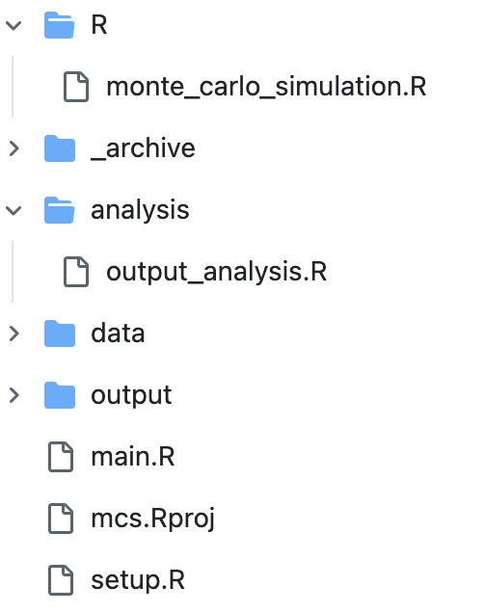
IMPLIMENTATION
CODE
POPULATION GENERATOR
LOAN APPROVER SIMULATOR
METHODS TO GENERATE PLOTS AND CHARTS
PLOTS & CHARTS FOR ANALYSIS
⭐️
ENTRY POINT
INITIALIZATION

Slide 6


IMPLIMENTATION
CODE
output.R
setup.R
⭐️
main.R
monte_carlo_simulation.R
output_analysis.R

Slide 7
MONTE CARLO SIMULATION
SIM
PURPOSE | DESCRIPTION
Quantify risk | Explore approval variability under different conditions
Test policies | Evaluate rule changes before implementing them
Analyze fairness | Detect disparities by subgroup (age, health, etc.)
Support compliance | Useful for ethics reviews or audits
Forecast outcomes | Predict approval rates, default, or profitability

Slide 8
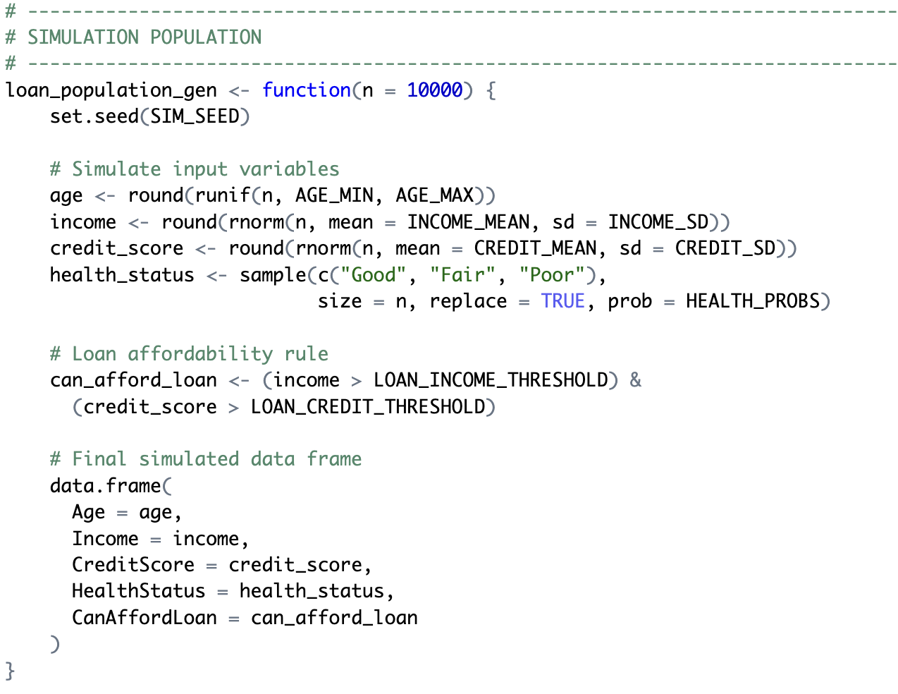
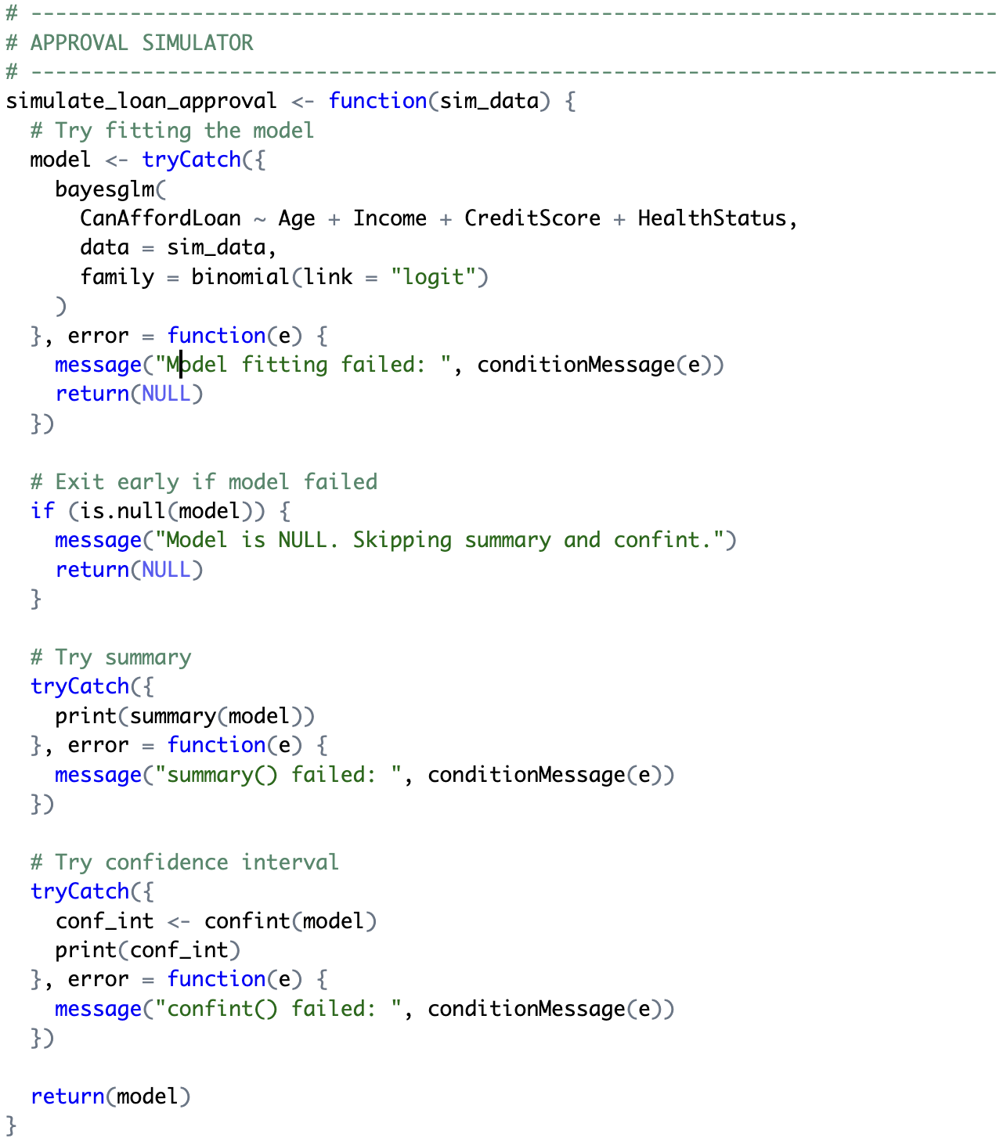
MONTE CARLO SIMULATION
SIM

Slide 9
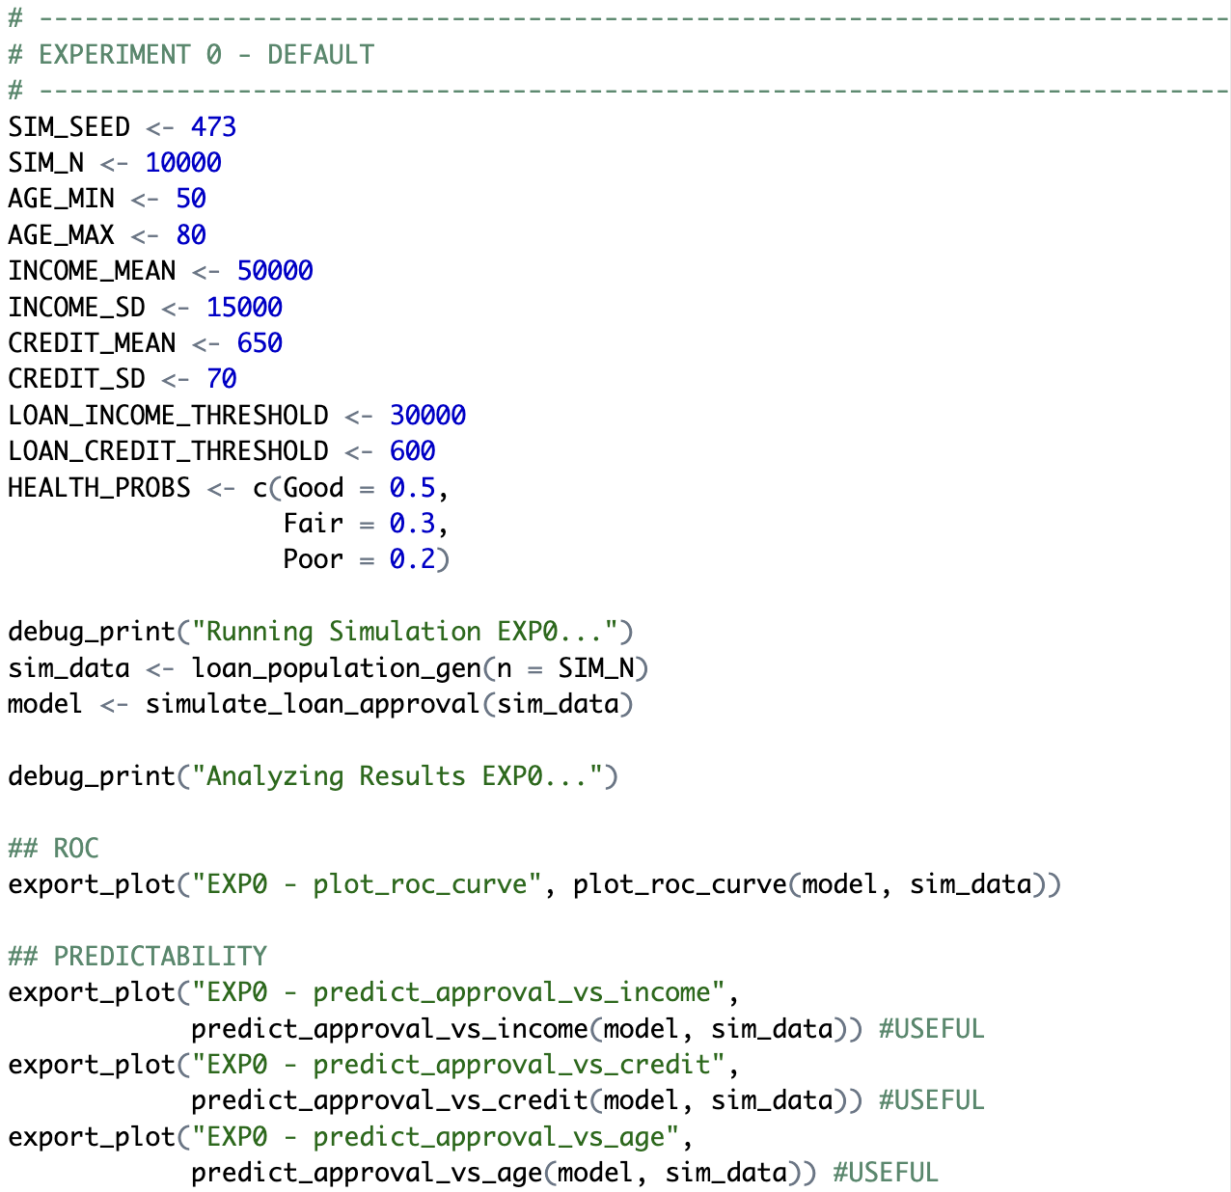
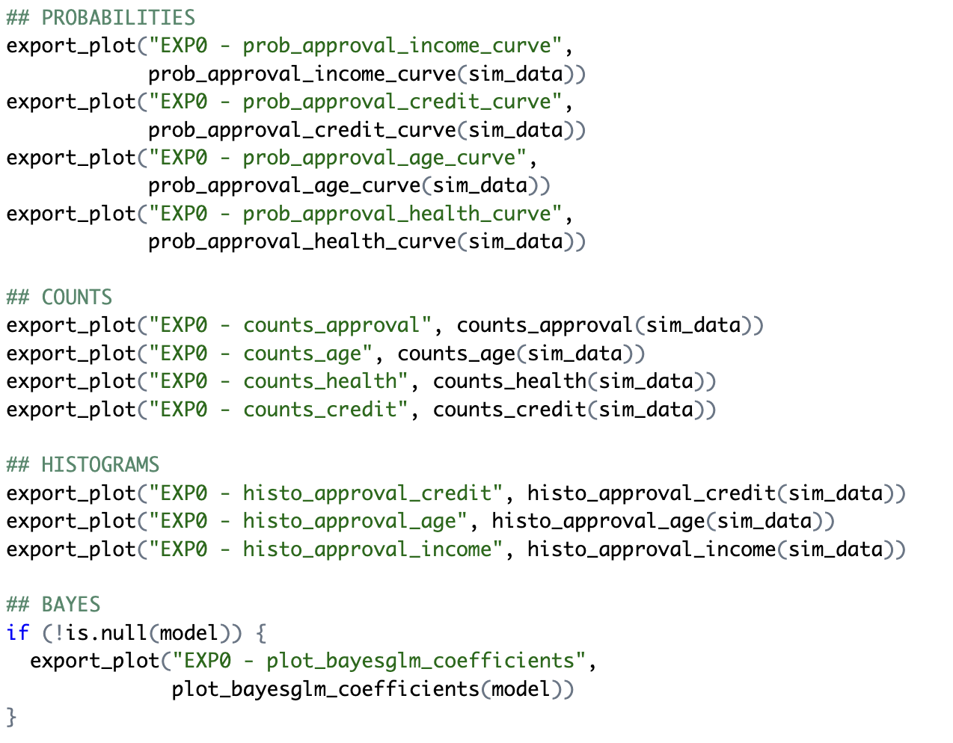
EXPERIMENTATIONS
SIM

Slide 10
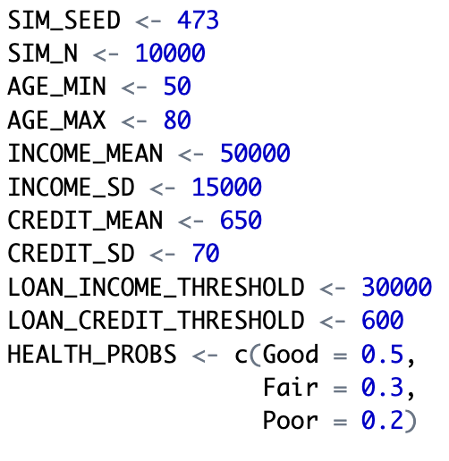
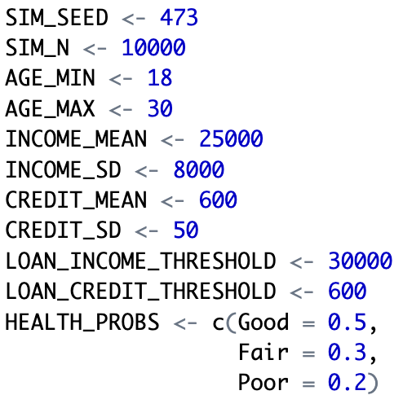
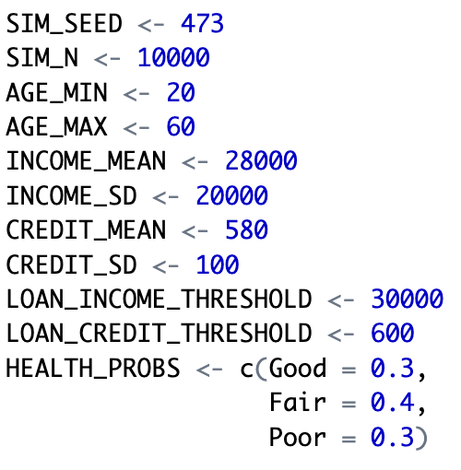
EXPERIMENTATIONS
SIM
EXPERIMENT 0
DEFAULT
EXPERIMENT 1
YOUNGER
EXPERIMENT 2
VARIABLE

Slide 11
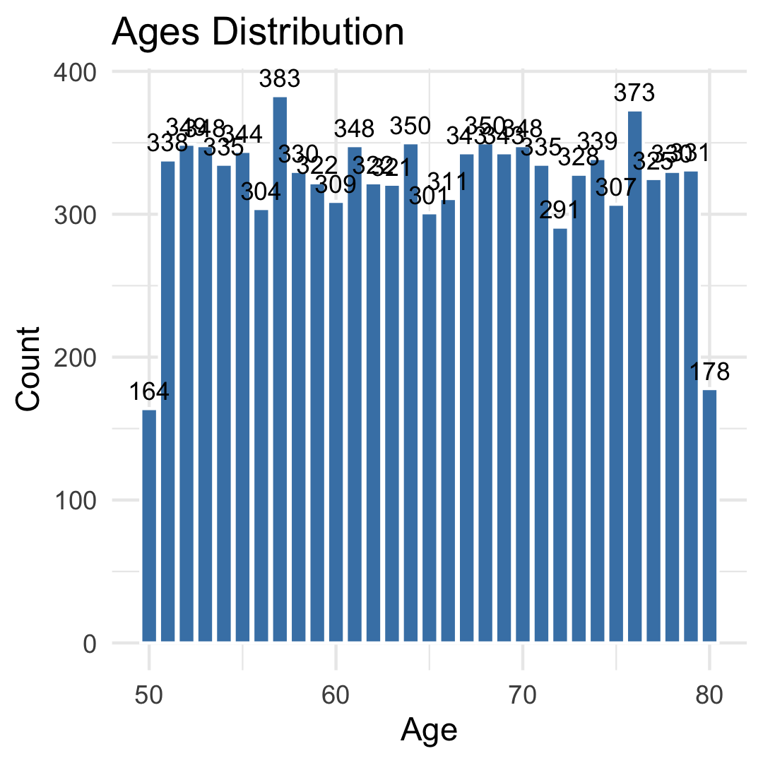
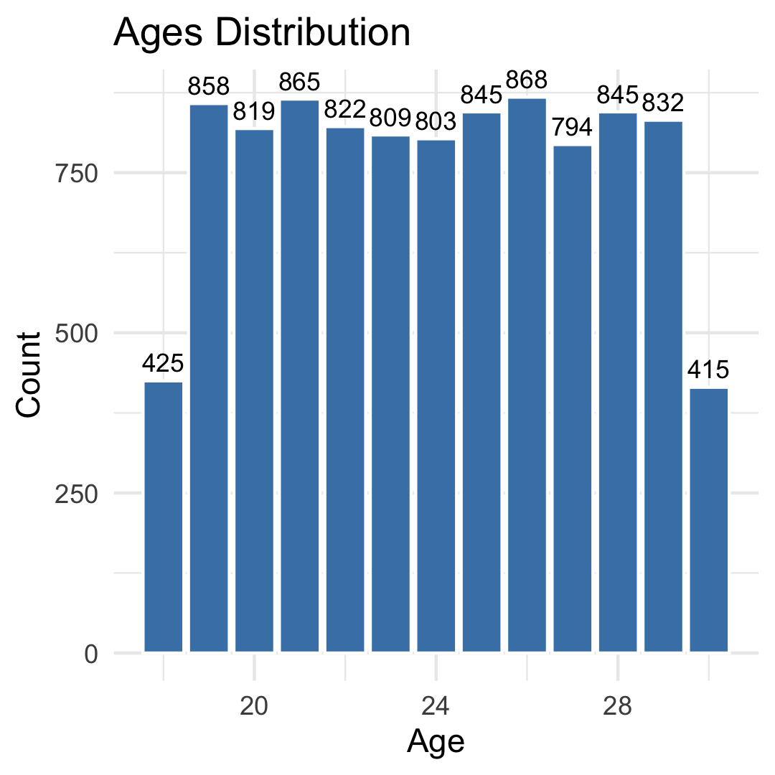
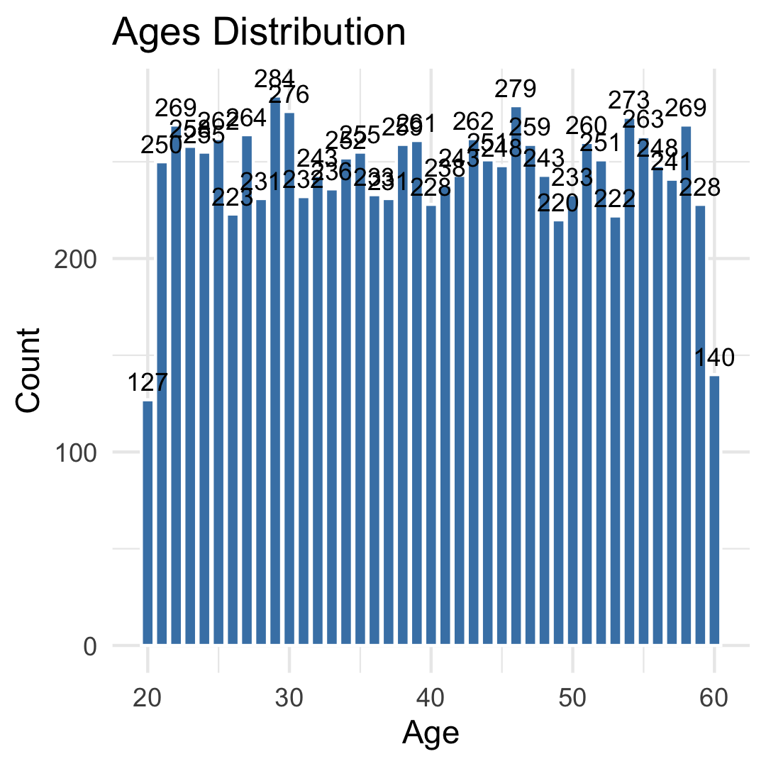
POPULATION DISTRIBUTION (AGE)
INSIGHT
EXPERIMENT 0
DEFAULT
EXPERIMENT 1
YOUNGER
EXPERIMENT 2
VARIABLE

Slide 12
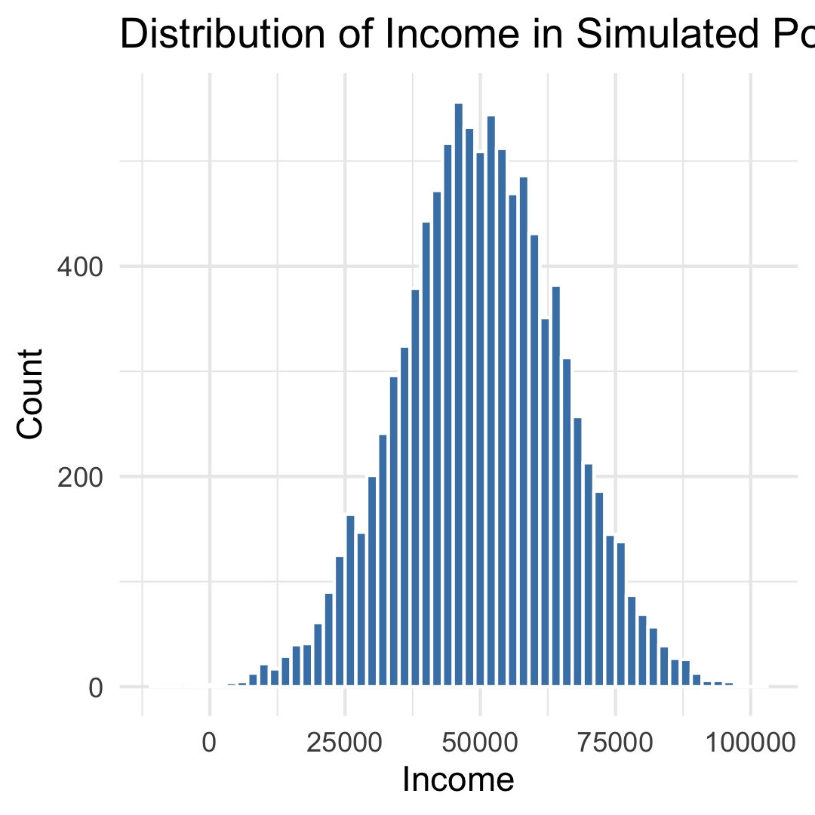
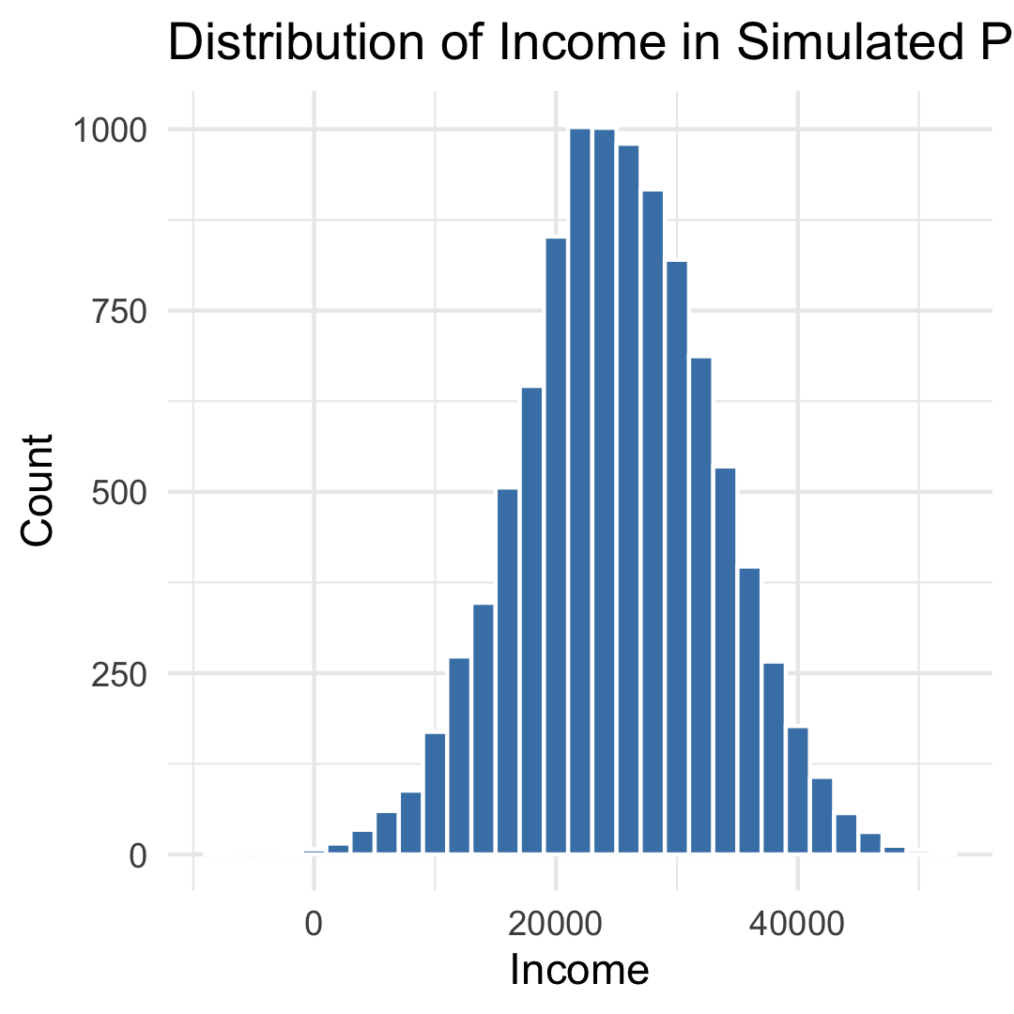
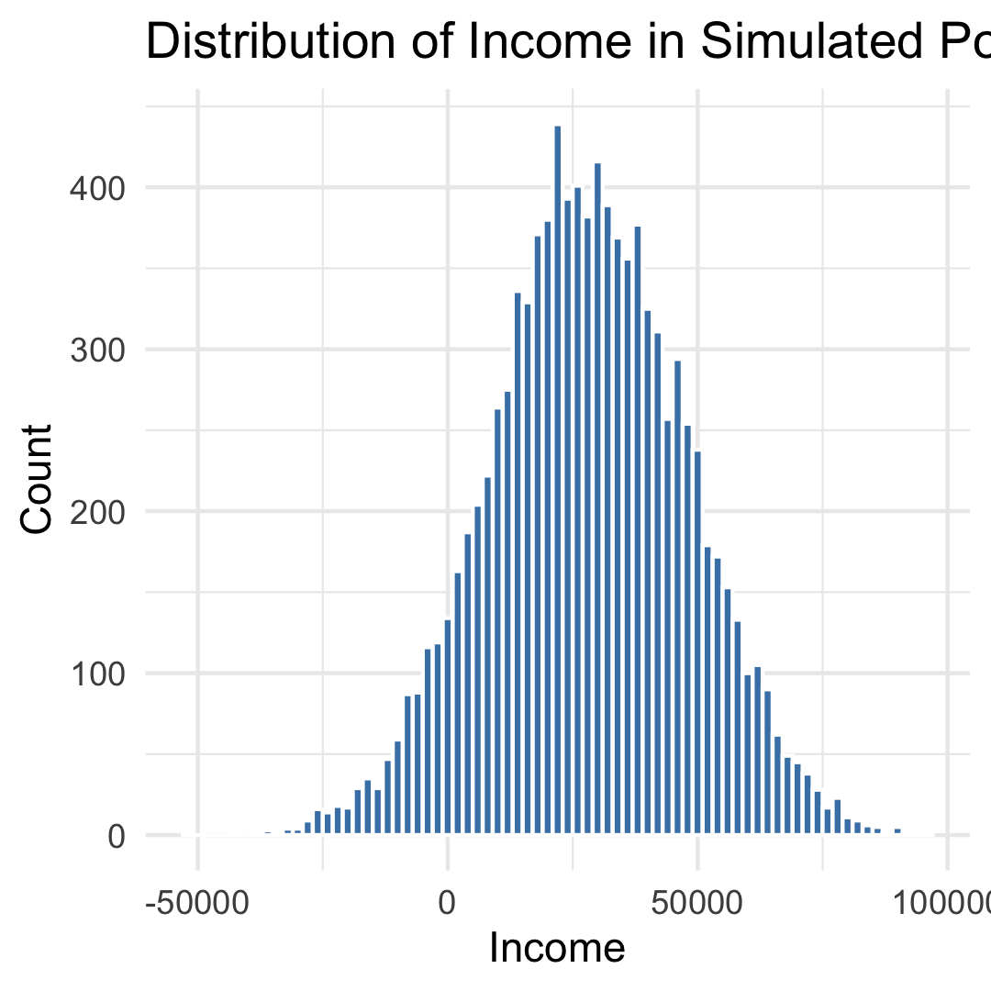
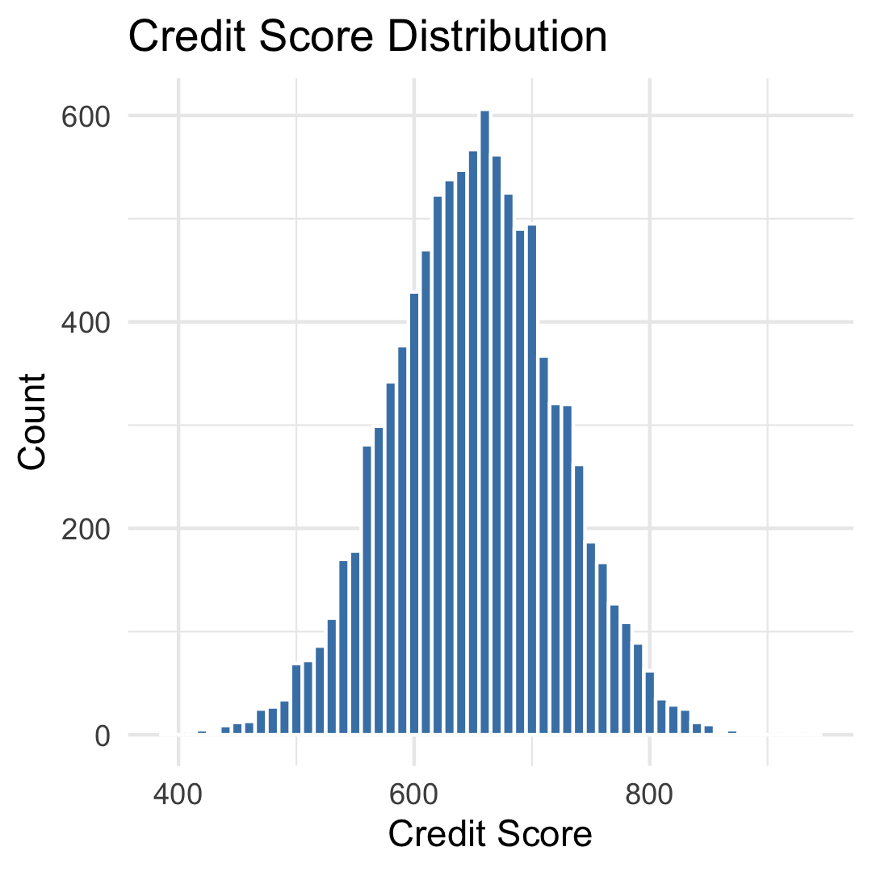
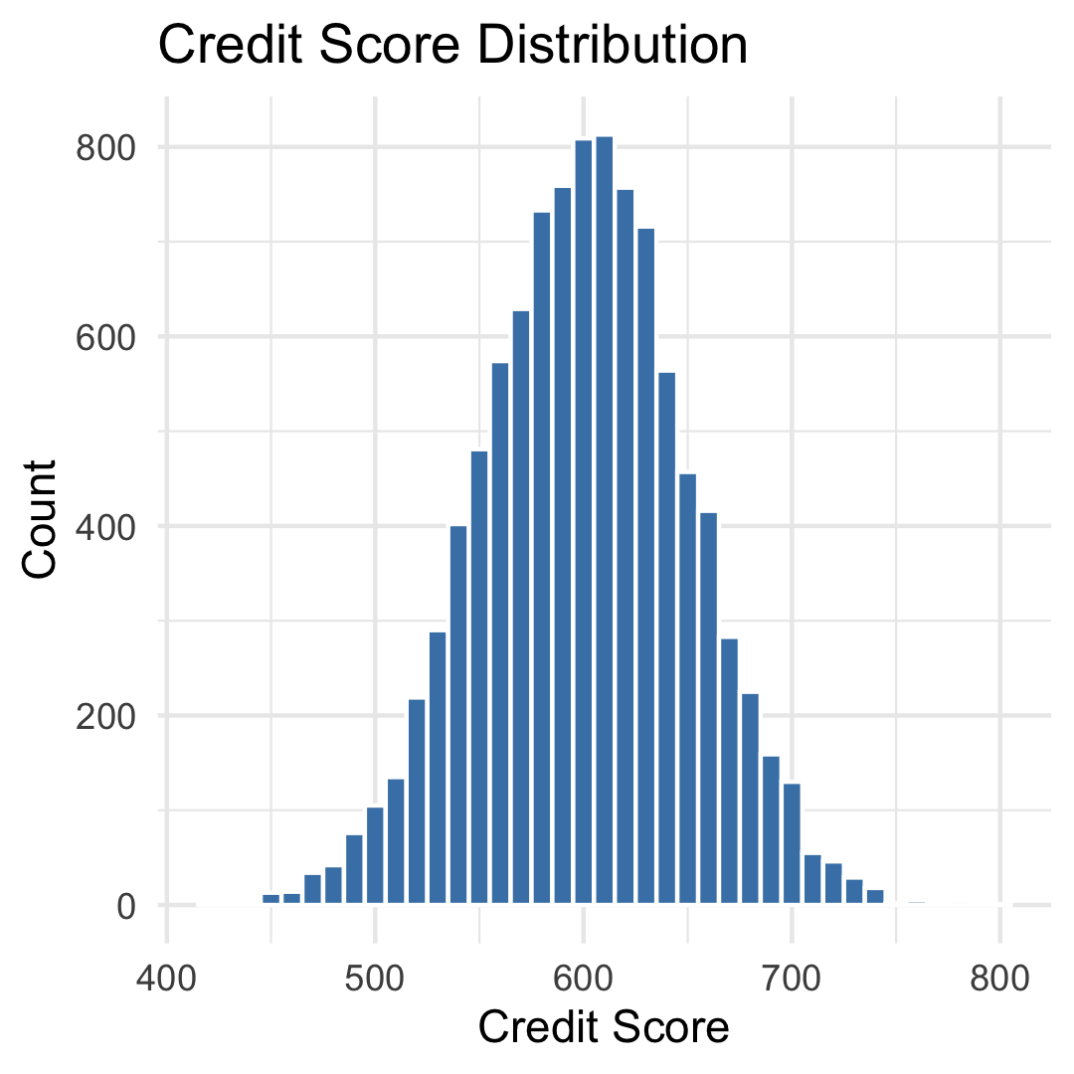

POPULATION DISTRIBUTION (INCOME)
INSIGHT
EXPERIMENT 0
DEFAULT
EXPERIMENT 1
YOUNGER
EXPERIMENT 2
VARIABLE

Slide 13
POPULATION DISTRIBUTION (CREDIT)
INSIGHT
EXPERIMENT 0
DEFAULT
EXPERIMENT 1
YOUNGER
EXPERIMENT 2
VARIABLE

Slide 14
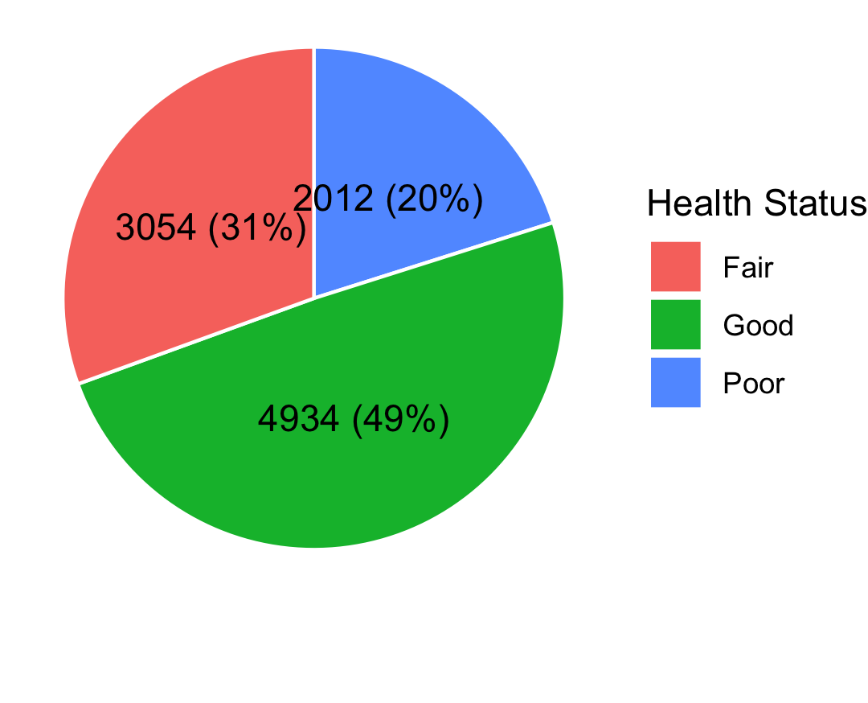
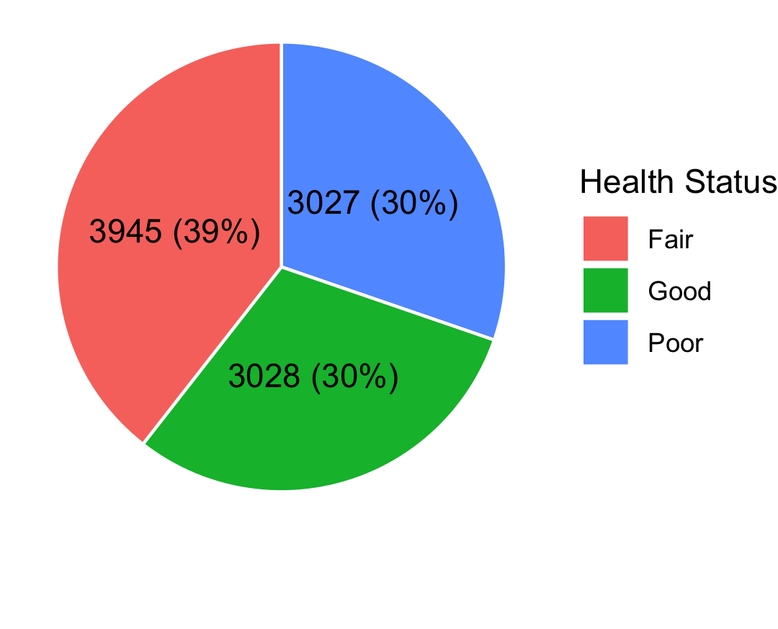
POPULATION DISTRIBUTION (HEALTH)
INSIGHT
EXPERIMENT 0
DEFAULT
EXPERIMENT 1
YOUNGER
EXPERIMENT 2
VARIABLE

Slide 15
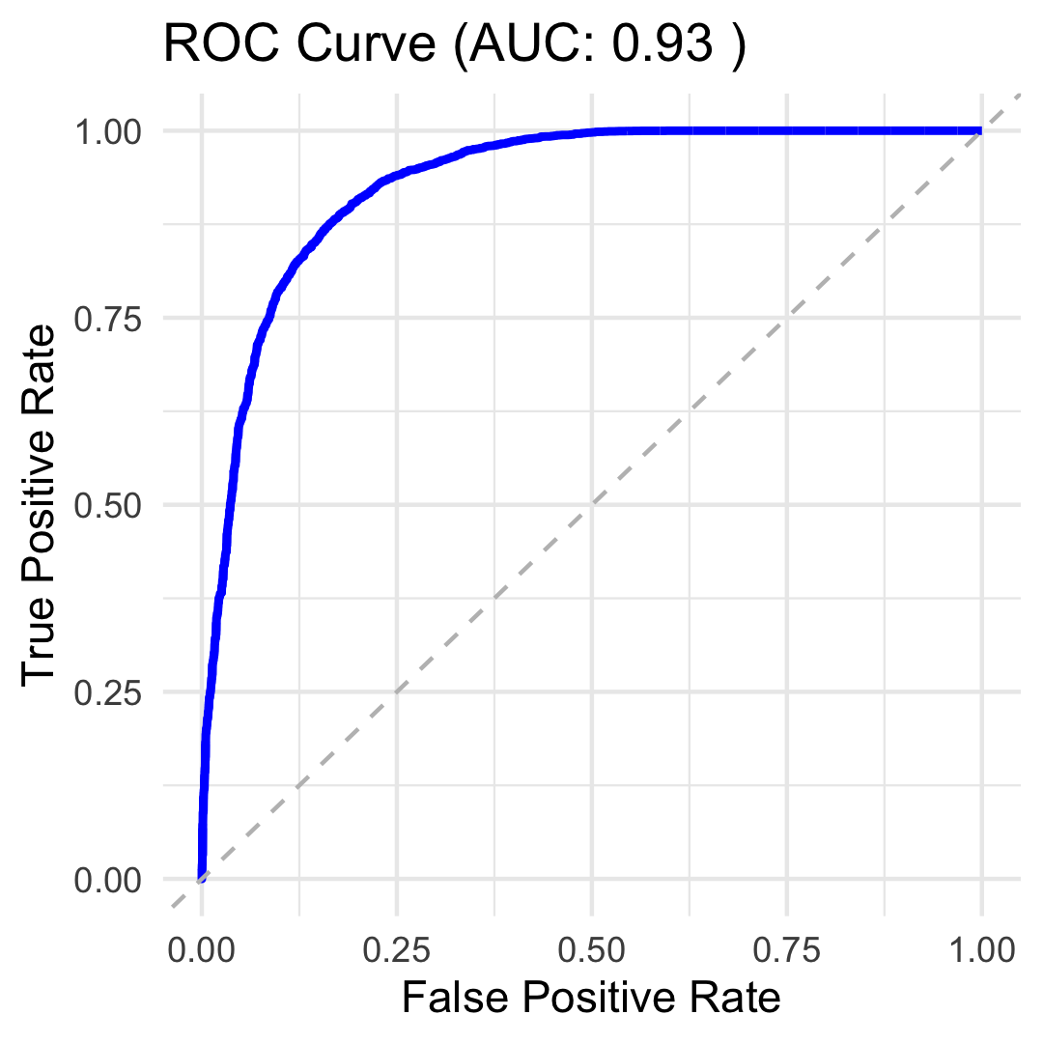
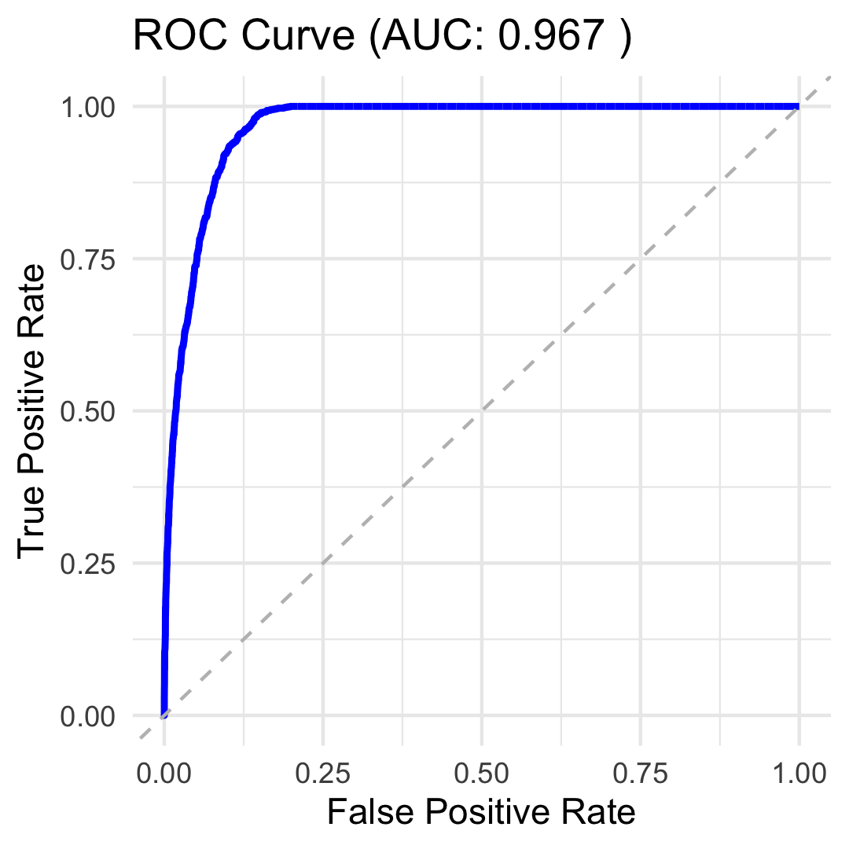
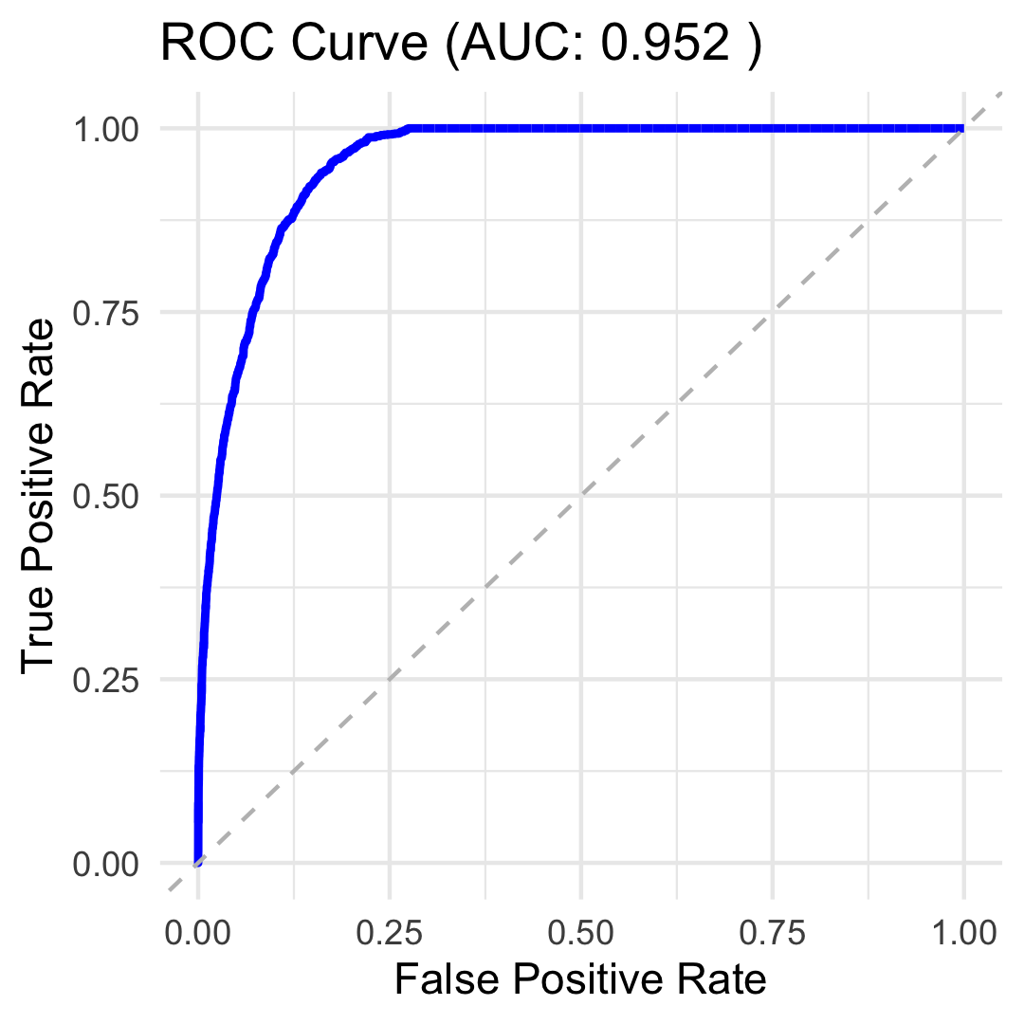
MODEL ANALYSIS
INSIGHT
EXPERIMENT 0
DEFAULT
EXPERIMENT 1
YOUNGER
EXPERIMENT 2
VARIABLE

Slide 16
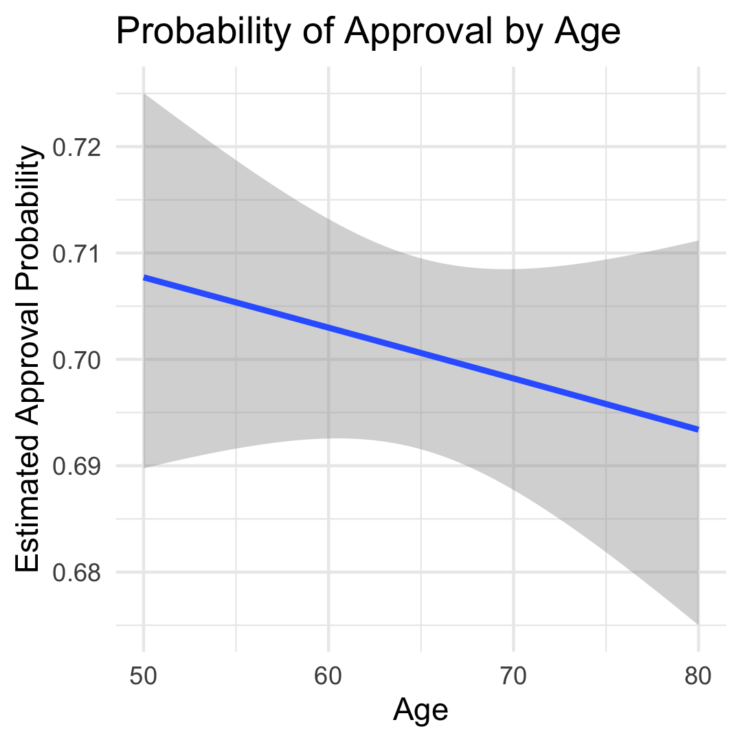
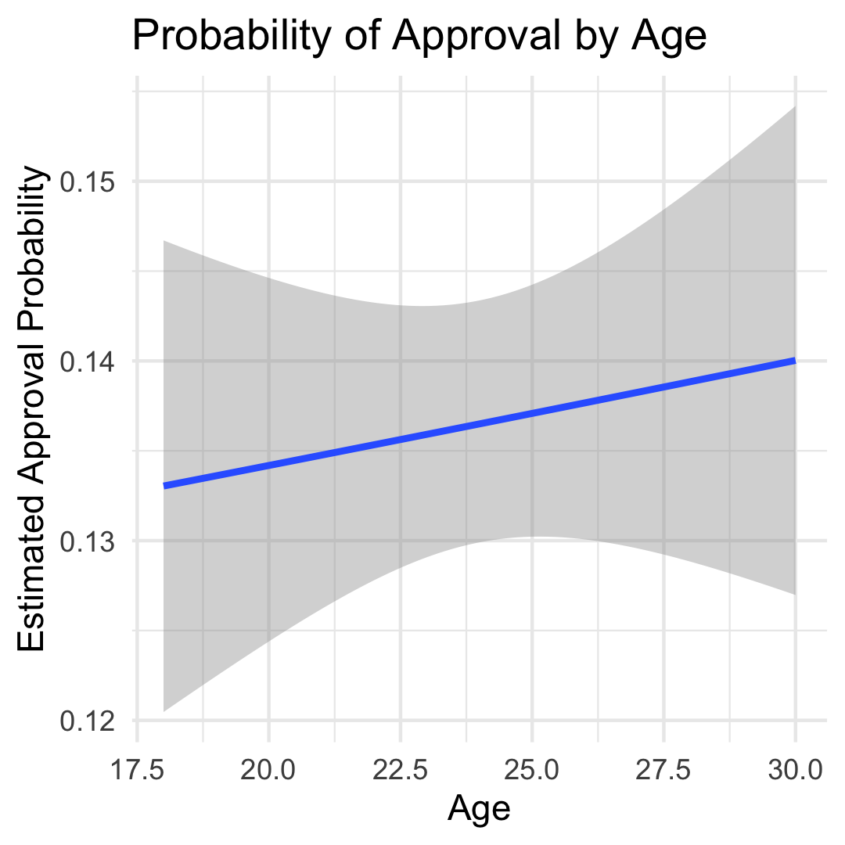
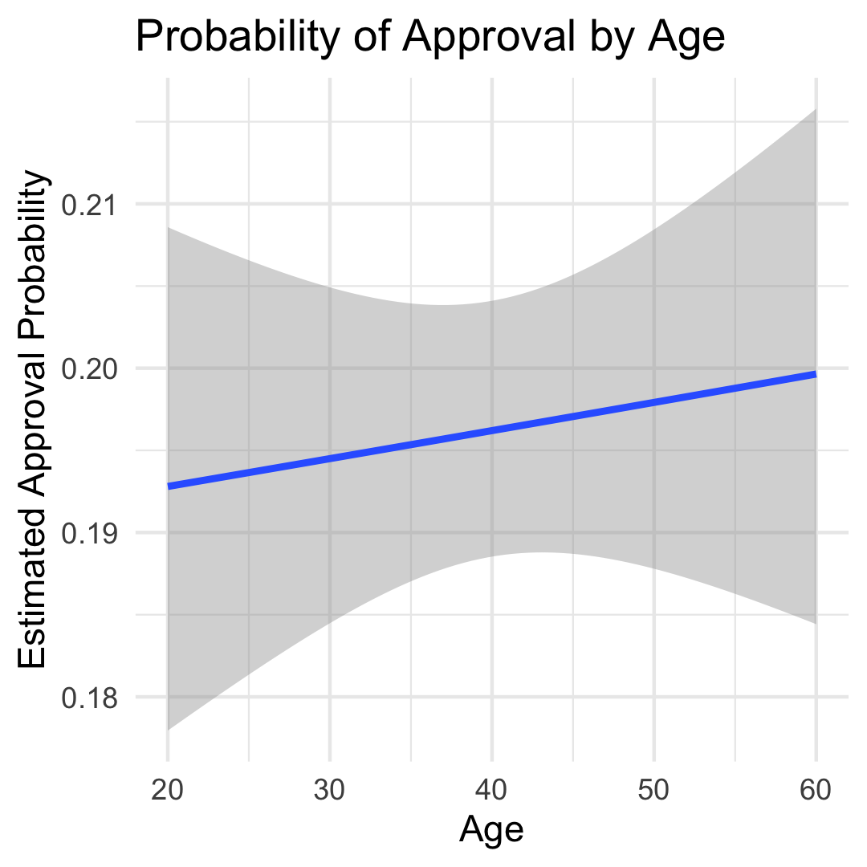
MODEL ANALYSIS
INSIGHT
EXPERIMENT 0
DEFAULT
EXPERIMENT 1
YOUNGER
EXPERIMENT 2
VARIABLE

Slide 17
ARTIFICAL INTELLIGENCE (AI) USE
INSIGHT
PURPOSE | DESCRIPTION
Debug Errors | Quickly explore why an error is caused and how to resolve
Brainstorming | Tool to facilitate exploration in thought and approaches within the scope of statistics and R
Query for Methods | Discover methods quickly that will facilitate goal / application
R Reference Guide | Use like a book when exploring the R language and its associated libraries
Best Practices | Explore how the R community generally develops (e.g. folder structures, naming conventions, etc.)
Refactoring | Leverage to discover approaches for simplifying source for clarity and readability

Slide 18
CONCLUSIONS
INSIGHT
??

Slide 19
Loan Approval Risk Simulation for an Aging Population
2025
Explores how loan approval outcomes and financial risk evolve as populations age
MIHRET TESFAYE (LEAD)
JOSHUA DAVIS

